Slide 1
DoorDash Product Pitch
Food delivery using Self-Driving Robots
Product Owner: Ayileye DAYO
© 2019 Udacity. All rights reserved.

Slide 2
Background
Why Are We Here?
Ever wondered how to make small deliveries more efficient and profitable?
Can we reduce carbon footprint and make deliveries close to environmental best possible standard?
Is there a way to reduce the required human effort in short, small deliveries?
Can we reduce both operating cost and the resultant consumer charge on small distance deliveries?
[Robo-Dasher]
© 2019 Udacity. All rights reserved.

Slide 3
Business Case
© 2019 Udacity. All rights reserved.
Notes:
[ALL PARTICIPATION]

Slide 4
Initial Focus
Our Journey so far
At DoorDash , we have been providing services to customers and merchants since 2012 across 5 countries with the aid of our efficient Dashers.
With our last-mile logistics infrastructure we have been able to deliver on both user sides.
We currently hold a 56% market share with revenue generated via delivery fee and commission on every order, advertisment and marketing.
https://www.doordash.com/en-US/about
https://en.Wikipedia.org/wiki/DoorDash
© 2019 Udacity. All rights reserved.

Slide 5
Initial Focus
Concerns
Comparatively higher delivery and commission fees
Operation cost
Increasing competitors for market share
http://www.ameranth.com/pdf/How%20Does%20DoorDash%20Make%20Money,%20Feb%2012,%202019.pdf
© 2019 Udacity. All rights reserved.

Slide 6
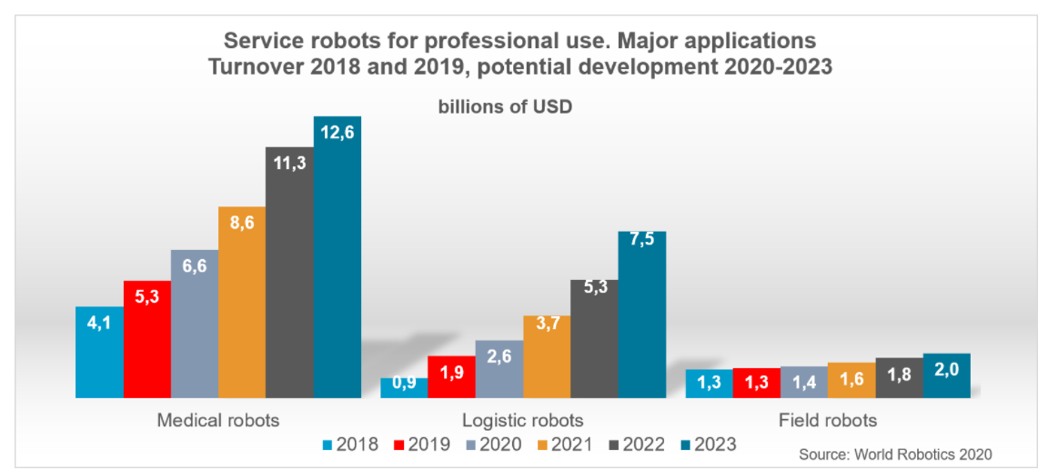
Opportunity
With advancement in autonomous technology and robotics , there has been an increase in the use of automation and service robots in customer based sectors like health care, home maintenance, delivery etc.
One out of three professional service robots sold in 2020 was built for the transportation of goods or cargo
Service robot market has a projected CAGR > 21% over till 2027.
Advent and deployment of Lidar technology
https://ifr.org/service-robots https://ifr.org/img/worldrobotics/Executive_Summary_WR_Service_Robots_2021.pdf
https://www.astuteanalytica.com/industry-report/service-robots-market
© 2019 Udacity. All rights reserved.

Slide 7
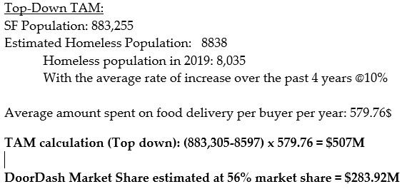
Opportunity - TAM
The direct users of this product is our Doordash operators who would be able to assist our actual customers track, route the Robo-Dasher and also manually control the Robo-dasher. However the target users in the long run , are Doordash customers who have order and are in need of a this product.
With a planned roll out in San Francisco, we have estimated the ‘TAM” for the rollout phase as
© 2019 Udacity. All rights reserved.

Slide 8
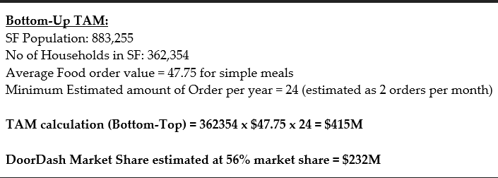
Opportunity - TAM
The direct users of this product is our Doordash operators who would be able to assist our actual customers track, route the Robo-Dasher and also manually control the Robo-dasher. However the target users in the long run , are Doordash customers who have order and are in need of a this product.
With a planned roll out in San Francisco, we have estimated the ‘TAM” for the rollout phase as
© 2019 Udacity. All rights reserved.

Slide 9
Proposal
What’s Our Solution?
Deployment of Autonoums Robots (Robo-Dashers) to handle small deliveries within a 2 mile radius.
Human Dashers handle larger orders and long distance delivery.
Reduced operation cost
Reduced delievry fee charge on customer
Reduced Carbon Footprint
© 2019 Udacity. All rights reserved.

Slide 10
Return On Investment
Link to spreadsheet
What can we do?
Estimated cost for development and operating
Estimated Net income from deployment
$ROI= \frac{revenue−expensees}{expense}\%=\frac{5.35M−3.804M}{3.804M}=39.3\%$
© 2019 Udacity. All rights reserved.

Slide 11
Measurement
How will we know if we’re successful?
Increase in booking orders for small deliveries by 25%
Increase in positive reviews from customers and merchant that place and provide small delivery by 7%
Increase in market share capitalization > 3%
Reduction in Operating cost > 10%
Reduction in delivery carbon footprint by 15-20%
© 2019 Udacity. All rights reserved.

Slide 12
Competitors
© 2019 Udacity. All rights reserved.
Notes:
[ALL PARTICIPATION]

Slide 13
Grubhub
Formely GrubHub seamless and currently owned by Netherland based Just Eat Takeaway.
Founded in 2004 and services just the United States Market.
Currently facing a decline in Net Income
No plans in place to deploy robot technology
Slower delivery and App technology is very limited.
https://en.wikipedia.org/wiki/Grubhub
© 2019 Udacity. All rights reserved.

Slide 14
Postmates
Founded in 2011 , Operates in 2940 U.S cities .
Rolled back on internationalization plans
Focuses on delivery of consumer goods
Currently developing Autonomous delivery rover
https://en.wikipedia.org/wiki/Postmates
© 2019 Udacity. All rights reserved.

Slide 15
Uber Eats
Founded in 2014 , sprouted out of ride Sharing company-Uber.
Global presence.
Currently working on delivery via drones
Drone deployment is currently skeptic – No regulations, safety risks etc.
https://en.wikipedia.org/wiki/Uber_Eats
© 2019 Udacity. All rights reserved.

Slide 16


Competitors Overview
 | UBER EATS | POSTMATES | GRUBHUB
Global presence
Autonomous Tech.
Focus on Food Delivery
Order Tracking via App
Order tracking via Customer care

Slide 17
Our Advantages
Why are we better?
We hold 56% market share in the food delivery space
Wide and dominant presence in USA, Canada.
Easy to use app with proven food tracking technology.
Timely deliveries.
Significant number of exclusive customers compared to competitors
Proven track record with restaurant franchises.
https://www.doordash.com/en-US/about
https://en.Wikipedia.org/wiki/DoorDash
https://www.doordash.com/en-US/about
https://en.Wikipedia.org/wiki/DoorDash
https://secondmeasure.com/datapoints/food-delivery-services-grubhub-uber-eats-doordash-postmates/
© 2019 Udacity. All rights reserved.

Slide 18
Roadmap and Vision
© 2019 Udacity. All rights reserved.
Notes:
[ALL PARTICIPATION]

Slide 19
Roadmap Pillars
Where do we go from here?
 | Q1 | Q2 | Q3 | Q4
Development of Robots with Partner Company (Hardware) | Design and Build prototype to serve functionality | Camera, Sensors and Mobility | Security, Integration with Software | Field Testing
App Development (Software) | Map updates and location mapping. | Route detection, Computer vision programs Human needed control interface | Customer side software interface with Robot. App update to include Robo-Dash use | Field Testing
© 2019 Udacity. All rights reserved.

Slide 20
Hardware Development
Robot protyping
Development and design and mechanical build.
Integaration of hardwares that would serves as software complements – cameras, wheels
Testing
Robot balance when under weights
Movement on various surfaces
Anti-theft protection and security
© 2019 Udacity. All rights reserved.

Slide 21
Software Development
Updates to map to include sidewalks routing
OpenCV and computer vision
Lidar technology integration
Object detection.
Human interface for Robo-Dasher control
Customer interface for interation during Robo-Dasher delivery.
Software security
Integration with Hardware team
Develop the current app to integrate Robo-Dasher
© 2019 Udacity. All rights reserved.

Slide 22
Where do we go from here?
Widening the scope
Testing in major USA cities
Further development to reduce Human interference in Robo-Dasher delivery
Improve the delivery radius of Robo-Dasher.
Improve delivery speed and load carrying capacity of Robo- Dasher.
Further intelligent conversation by Robo-Dasher
© 2019 Udacity. All rights reserved.

Slide 23
Thank You
© 2019 Udacity. All rights reserved.
Notes:
[ALL PARTICIPATION]

